Slide 1
Linear Algebra and Calculus
Unit-I: Matrices
Introduction of Matrix
Rank of a Matrix
Canonical Form of a Matrix (Echelon Form)
Normal Form of a Matrix
System of Linear Equations
Linear and Orthogonal Transformations
Eigen Values and Eigen Vectors
Diagonalization of Matrices
Cayley Hamilton Theorem
Applications to problems in Engineering

Slide 2

Linear Transformation
Let us consider
$y_{1}=a_{11}x_{1}+a_{12}x_{2}+a_{13}x_{3}+…+a_{1n}x_{n}$
$y_{2}=a_{21}x_{1}+a_{22}x_{2}+a_{23}x_{3}+…+a_{2n}x_{n}$
$y_{3}=a_{31}x_{1}+a_{32}x_{2}+a_{33}x_{3}+…+a_{3n}x_{n}$
- - - - - - - - - - - - - - - - - - - - - - - - - - - - - -
$y_{n}=a_{n1}x_{1}+a_{n2}x_{2}+a_{n3}x_{3}+…+a_{nn}x_{n}$
It can be written as
$\left[\begin{matrix}y_{1} \\ y_{2} \\ y_{3} \\ ⋮ \\ y_{n}\end{matrix}\right]=\left[\begin{matrix}a_{11} & a_{12} & a_{13} & … & a_{1n} \\ a_{21} & a_{22} & a_{23} & … & a_{2n} \\ a_{31} & a_{32} & a_{33} & … & a_{3n} \\ ⋮ & ⋮ & ⋮ & … & ⋮ \\ a_{n1} & a_{n2} & a_{n3} & … & a_{nn}\end{matrix}\right]$$\left[\begin{matrix}x_{1} \\ x_{2} \\ x_{3} \\ ⋮ \\ x_{n}\end{matrix}\right]$$⇒$$Y=AX$
$⇒$$y_{1}, y_{2}, y_{3}, ,…, y_{n}$ can be expressed in terms of $x_{1}, x_{2}, x_{3}, ,…, x_{n}$.
$⇒$$y_{1}, y_{2}, y_{3}, ,…, y_{n}$ is linear transformation of $x_{1}, x_{2}, x_{3}, ,…, x_{n}$.

Slide 3

Properties of Linear Transformation
Suppose $Y=AX$is a linear transformation from X to Y.
A is called Linear Operator.
$\left|A\right|$ is called Modulus of Transformation.
If $\left|A\right|≠0$, then the transformation is called Regular or Non-singular.
If $\left|A\right|=0$, then the transformation is called Non-Regular or Singular.
If the transformation is Regular, then $X=A^{−1}Y$ is called Inverse Regular Transformation.
If the A is regular, then $A^{−1}$ is also Regular.
If $Y=AX$ is linear transformation from X to Y and $Z=BY$ is a linear transformation from Y to Z, then $Z=BY=B\left(AX\right)=\left(BA\right)X$ is called Composite Transformation of from X to Z.
A regular linear transformation carries linearly independent vectors into linearly independent vectors.
A regular linear transformation carries linearly dependent vectors into linearly dependent vectors.

Slide 4
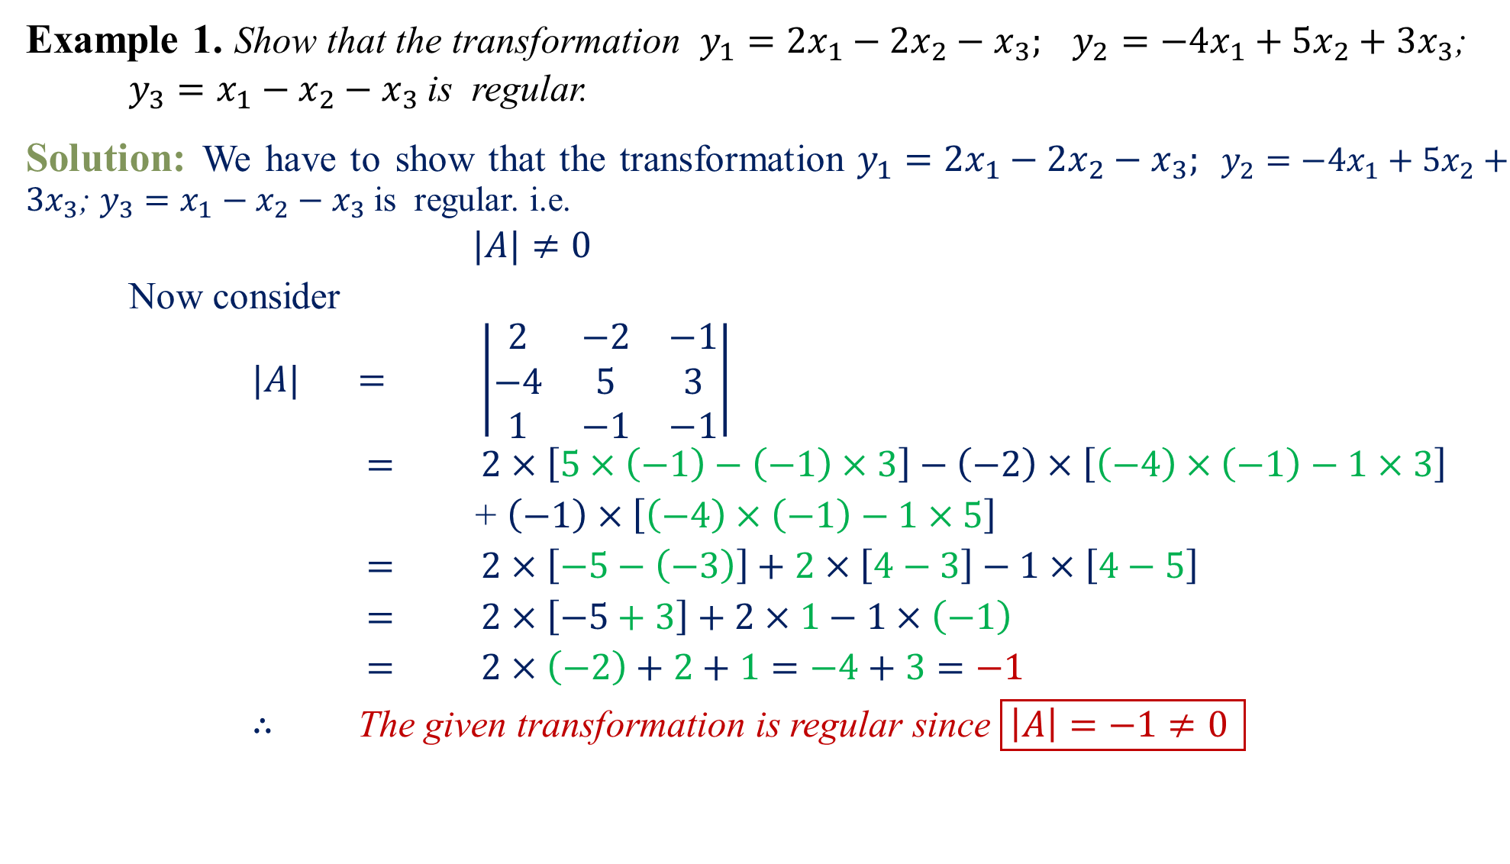
Example 1.Show that the transformation $y_{1}=2x_{1}−2x_{2}−x_{3}; y_{2}=−4x_{1}+5x_{2}+3x_{3}$;
$y_{3}=x_{1}−x_{2}−x_{3}$is regular.
Solution:We have to show that the transformation $y_{1}=2x_{1}−2x_{2}−x_{3}; y_{2}=−4x_{1}+5x_{2}+3x_{3}$; $y_{3}=x_{1}−x_{2}−x_{3}$is regular. i.e.
$|A|≠0$
Now consider
$|A|$$=$$\left|\begin{matrix}2 & −2 & −1 \\ −4 & 5 & 3 \\ 1 & −1 & −1\end{matrix}\right|$
$=$$2×\left[5×\left(−1\right)−\left(−1\right)×3\right]−\left(−2\right)×\left[\left(−4\right)×\left(−1\right)−1×3\right]$
+$\left(−1\right)×\left[\left(−4\right)×\left(−1\right)−1×5\right]$
$=$$2×\left[−5−\left(−3\right)\right]+2×\left[4−3\right]−1×\left[4−5\right]$
$=$$2×\left[−5+3\right]+2×1−1×\left(−1\right)$
$=$$2×\left(−2\right)+2+1=−4+3=−1$
$∴$ The given transformation is regular since $\boxed{\left|A\right|=−1≠0 }$

Slide 5
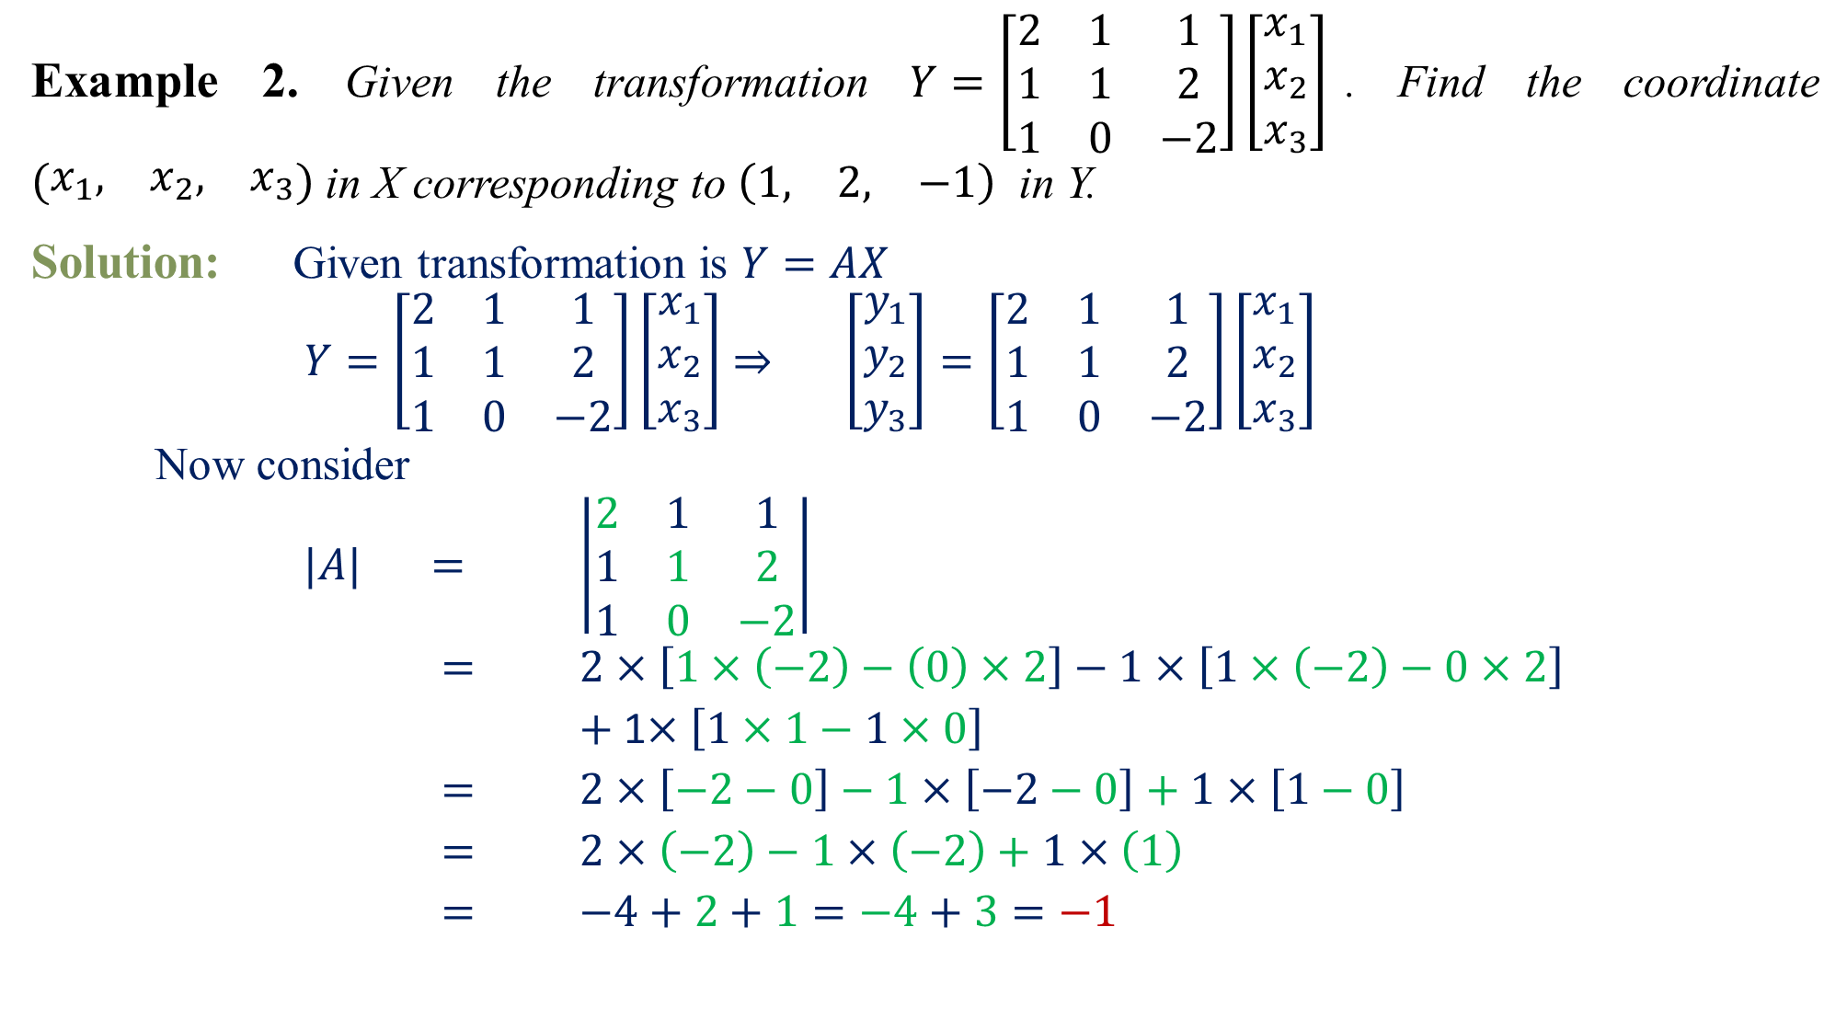
Example 2.Given the transformation $Y=\left[\begin{matrix}2 & 1 & 1 \\ 1 & 1 & 2 \\ 1 & 0 & −2\end{matrix}\right]\left[\begin{matrix}x_{1} \\ x_{2} \\ x_{3}\end{matrix}\right]$. Find the coordinate $\left(\begin{matrix}x_{1}, & x_{2}, & x_{3}\end{matrix}\right)$ in X corresponding to $\left(\begin{matrix}1, & 2, & −1\end{matrix}\right)$ in Y.
Solution: Given transformation is $Y=AX$
$Y=\left[\begin{matrix}2 & 1 & 1 \\ 1 & 1 & 2 \\ 1 & 0 & −2\end{matrix}\right]\left[\begin{matrix}x_{1} \\ x_{2} \\ x_{3}\end{matrix}\right]$$⇒$$\left[\begin{matrix}y_{1} \\ y_{2} \\ y_{3}\end{matrix}\right]=\left[\begin{matrix}2 & 1 & 1 \\ 1 & 1 & 2 \\ 1 & 0 & −2\end{matrix}\right]\left[\begin{matrix}x_{1} \\ x_{2} \\ x_{3}\end{matrix}\right]$
Now consider
$|A|$$=$$\left|\begin{matrix}2 & 1 & 1 \\ 1 & 1 & 2 \\ 1 & 0 & −2\end{matrix}\right|$
$=$$2×\left[1×\left(−2\right)−\left(0\right)×2\right]−1×\left[1×\left(−2\right)−0×2\right]$
$+$ 1$×\left[1×1−1×0\right]$
$=$$2×\left[−2−0\right]−1×\left[−2−0\right]+1×\left[1−0\right]$
$=$$2×\left(−2\right)−1×\left(−2\right)+1×\left(1\right)$
$=$$−4+2+1=−4+3=−1$
1
0
1
2
0
1
4
-
4
-

Slide 6
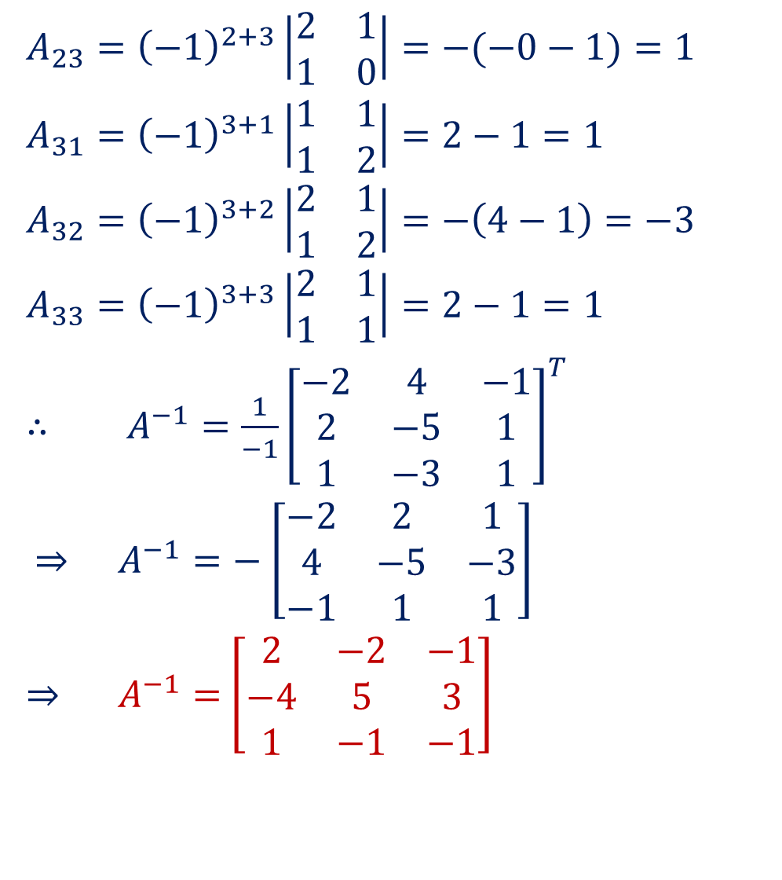
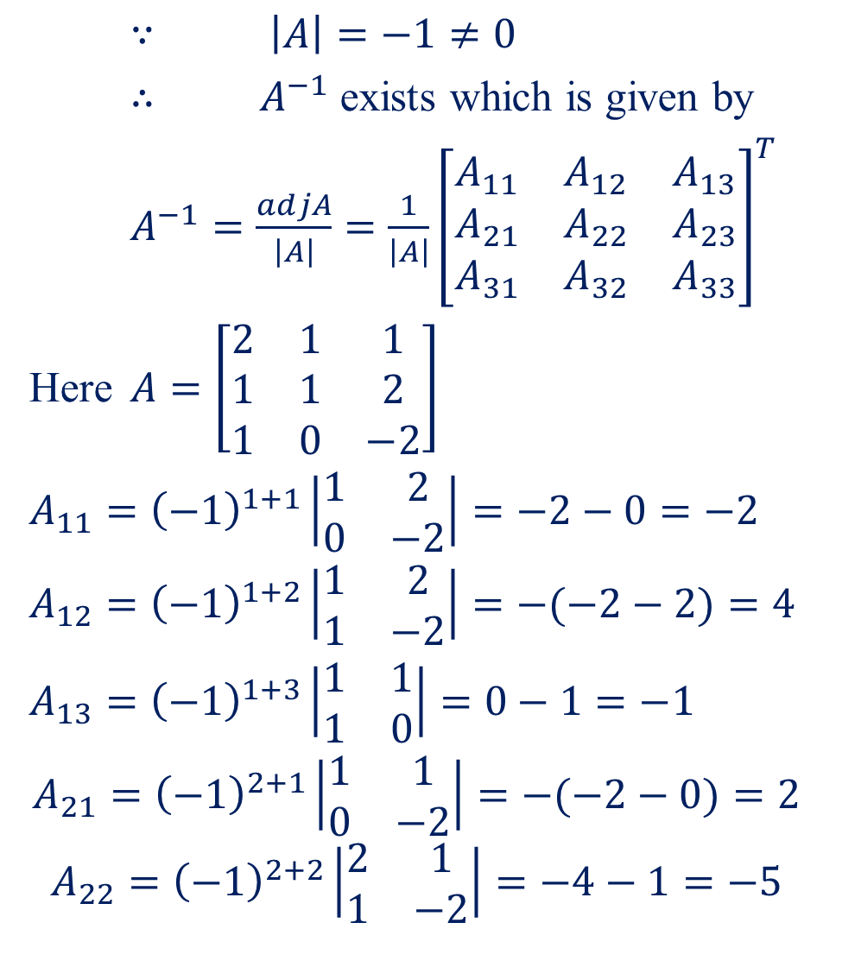
$∵$$\left|A\right|=−1≠0$
$∴$$A^{−1}$exists which is given by
$A^{−1}=\frac{adjA}{\left|A\right|}=\frac{1}{\left|A\right|}{\left[\begin{matrix}A_{11} & A_{12} & A_{13} \\ A_{21} & A_{22} & A_{23} \\ A_{31} & A_{32} & A_{33}\end{matrix}\right]}^{T}$
Here $A=\left[\begin{matrix}2 & 1 & 1 \\ 1 & 1 & 2 \\ 1 & 0 & −2\end{matrix}\right]$
$A_{11}={\left(−1\right)}^{1+1}\left|\begin{matrix}1 & 2 \\ 0 & −2\end{matrix}\right|=−2−0=−2$
$$A_{12}={\left(−1\right)}^{1+2}\left|\begin{matrix}1 & 2 \\ 1 & −2\end{matrix}\right|=−(−2−2)=4$$
$A_{13}={\left(−1\right)}^{1+3}\left|\begin{matrix}1 & 1 \\ 1 & 0\end{matrix}\right|=0−1=−1$
$$A_{21}={\left(−1\right)}^{2+1}\left|\begin{matrix}1 & 1 \\ 0 & −2\end{matrix}\right|=−(−2−0)=2$$
$$A_{22}={\left(−1\right)}^{2+2}\left|\begin{matrix}2 & 1 \\ 1 & −2\end{matrix}\right|=−4−1=−5$$
$$A_{23}={\left(−1\right)}^{2+3}\left|\begin{matrix}2 & 1 \\ 1 & 0\end{matrix}\right|=−(−0−1)=1$$
$A_{31}={\left(−1\right)}^{3+1}\left|\begin{matrix}1 & 1 \\ 1 & 2\end{matrix}\right|=2−1=1$
$$A_{32}={\left(−1\right)}^{3+2}\left|\begin{matrix}2 & 1 \\ 1 & 2\end{matrix}\right|=−\left(4−1\right)=−3$$
$$A_{33}={\left(−1\right)}^{3+3}\left|\begin{matrix}2 & 1 \\ 1 & 1\end{matrix}\right|=2−1=1$$
$∴$$A^{−1}=\frac{1}{−1}{\left[\begin{matrix}−2 & 4 & −1 \\ 2 & −5 & 1 \\ 1 & −3 & 1\end{matrix}\right]}^{T}$
$⇒$$A^{−1}=−$$\left[\begin{matrix}−2 & 2 & 1 \\ 4 & −5 & −3 \\ −1 & 1 & 1\end{matrix}\right]$
$⇒$$A^{−1}=$$\left[\begin{matrix}2 & −2 & −1 \\ −4 & 5 & 3 \\ 1 & −1 & −1\end{matrix}\right]$

Slide 7
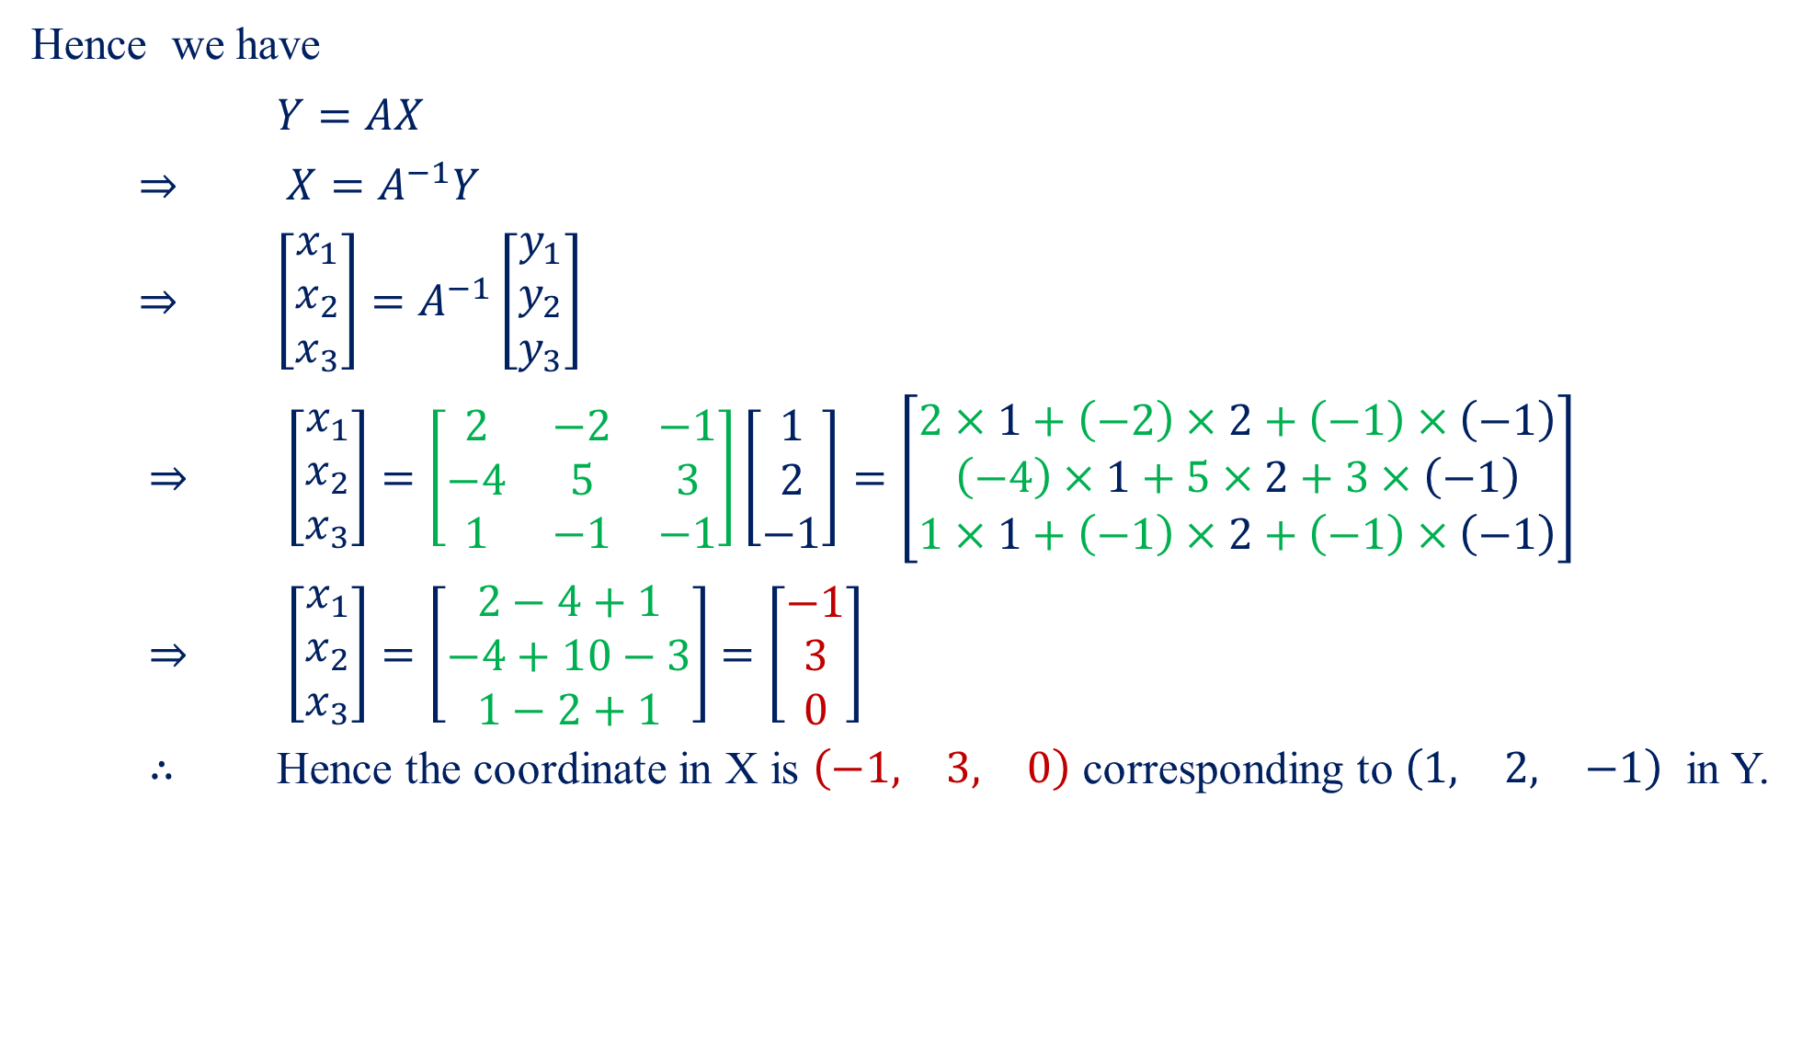
Hence we have
$Y=AX$
$⇒$$X=A^{−1}Y$
$⇒$$\left[\begin{matrix}x_{1} \\ x_{2} \\ x_{3}\end{matrix}\right]=A^{−1}\left[\begin{matrix}y_{1} \\ y_{2} \\ y_{3}\end{matrix}\right]$
$⇒$$\left[\begin{matrix}x_{1} \\ x_{2} \\ x_{3}\end{matrix}\right]=\left[\begin{matrix}2 & −2 & −1 \\ −4 & 5 & 3 \\ 1 & −1 & −1\end{matrix}\right]\left[\begin{matrix}1 \\ 2 \\ −1\end{matrix}\right]=\left[\begin{matrix}2×1+\left(−2\right)×2+\left(−1\right)×\left(−1\right) \\ \left(−4\right)×1+5×2+3×\left(−1\right) \\ 1×1+\left(−1\right)×2+\left(−1\right)×\left(−1\right)\end{matrix}\right]$
$⇒$$\left[\begin{matrix}x_{1} \\ x_{2} \\ x_{3}\end{matrix}\right]=\left[\begin{matrix}2−4+1 \\ −4+10−3 \\ 1−2+1\end{matrix}\right]$$=\left[\begin{matrix}−1 \\ 3 \\ 0\end{matrix}\right]$
$∴$Hence the coordinate in X is $\left(\begin{matrix}−1, & 3, & 0\end{matrix}\right)$ corresponding to $\left(\begin{matrix}1, & 2, & −1\end{matrix}\right)$ in Y.

Slide 8
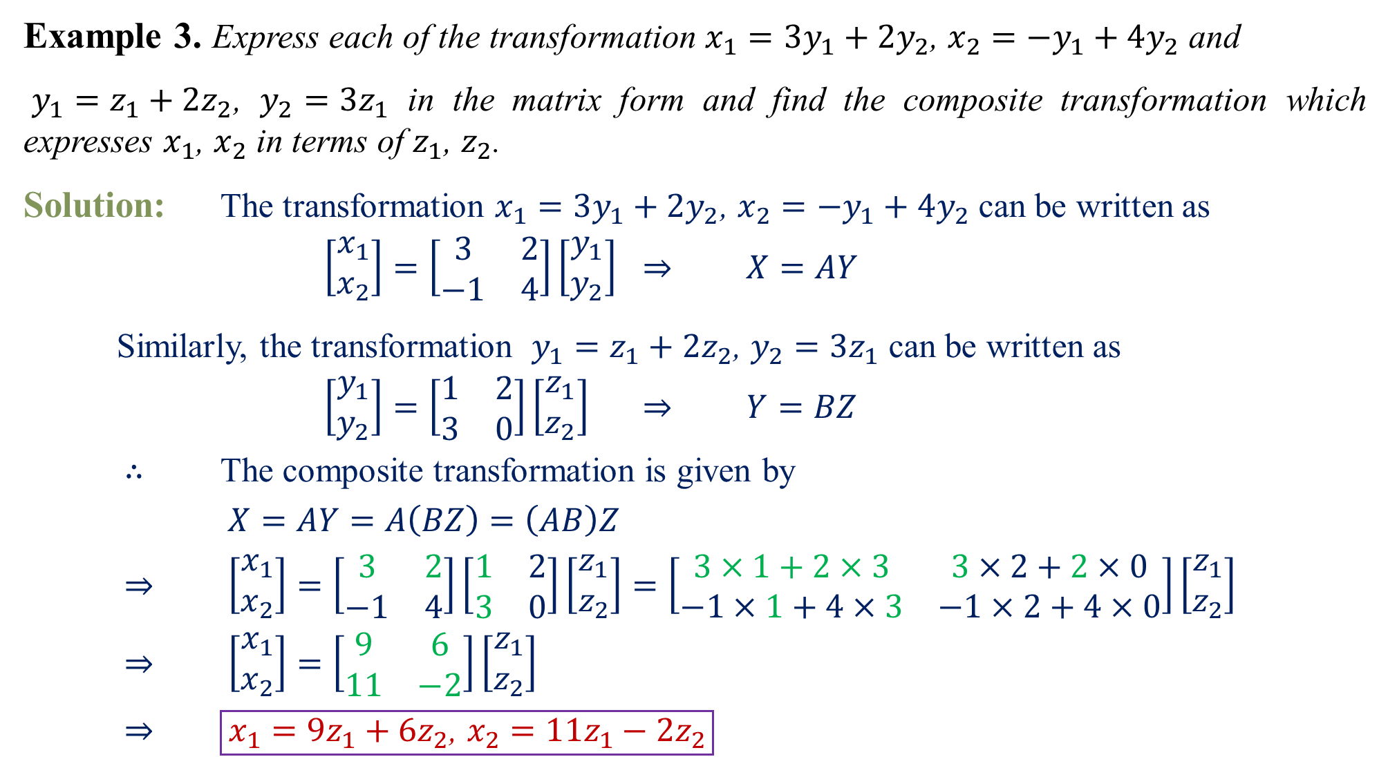
Example 3.Express each of the transformation $x_{1}=3y_{1}+2y_{2}$, $x_{2}=−y_{1}+4y_{2}$ and
$y_{1}=z_{1}+2z_{2}$, $y_{2}=3z_{1}$ in the matrix form and find the composite transformation which expresses $x_{1}$, $x_{2}$ in terms of $z_{1}$, $z_{2}$.
Solution: The transformation $x_{1}=3y_{1}+2y_{2}$, $x_{2}=−y_{1}+4y_{2}$ can be written as
$\left[\begin{matrix}x_{1} \\ x_{2}\end{matrix}\right]=\left[\begin{matrix}3 & 2 \\ −1 & 4\end{matrix}\right]\left[\begin{matrix}y_{1} \\ y_{2}\end{matrix}\right]$$⇒$$X=AY$
Similarly, the transformation $y_{1}=z_{1}+2z_{2}$, $y_{2}=3z_{1}$ can be written as
$\left[\begin{matrix}y_{1} \\ y_{2}\end{matrix}\right]=\left[\begin{matrix}1 & 2 \\ 3 & 0\end{matrix}\right]\left[\begin{matrix}z_{1} \\ z_{2}\end{matrix}\right]$$⇒$$Y=BZ$
$∴$The composite transformation is given by
$X=AY=A\left(BZ\right)=\left(AB\right)Z$
$⇒$$\left[\begin{matrix}x_{1} \\ x_{2}\end{matrix}\right]=\left[\begin{matrix}3 & 2 \\ −1 & 4\end{matrix}\right]\left[\begin{matrix}1 & 2 \\ 3 & 0\end{matrix}\right]\left[\begin{matrix}z_{1} \\ z_{2}\end{matrix}\right]=\left[\begin{matrix}3×1+2×3 & 3×2+2×0 \\ −1×1+4×3 & −1×2+4×0\end{matrix}\right]\left[\begin{matrix}z_{1} \\ z_{2}\end{matrix}\right]$
$⇒$$\left[\begin{matrix}x_{1} \\ x_{2}\end{matrix}\right]=\left[\begin{matrix}9 & 6 \\ 11 & −2\end{matrix}\right]\left[\begin{matrix}z_{1} \\ z_{2}\end{matrix}\right]$
$⇒$$\boxed{x_{1}={9z}_{1}+6z_{2}\text{, }x_{2}=11z_{1}−2z_{2}}$

Slide 9

Home Assignment
Given the transformation $Y=\left[\begin{matrix}4 & −5 & 1 \\ 3 & 1 & −2 \\ 1 & 4 & 1\end{matrix}\right]\left[\begin{matrix}x_{1} \\ x_{2} \\ x_{3}\end{matrix}\right]$. Find the coordinate $\left(\begin{matrix}x_{1}, & x_{2}, & x_{3}\end{matrix}\right)$ in X corresponding to $\left(\begin{matrix}2, & 9, & 5\end{matrix}\right)$ in Y .$\left[Ans:\left(\begin{matrix}2, & 1, & −1\end{matrix}\right)\right]$
Given the transformation $Y=\left[\begin{matrix}1 & 1 & −2 \\ 2 & −1 & 1 \\ 3 & 1 & −1\end{matrix}\right]\left[\begin{matrix}x_{1} \\ x_{2} \\ x_{3}\end{matrix}\right]$. Find the coordinate $\left(\begin{matrix}x_{1}, & x_{2}, & x_{3}\end{matrix}\right)$ in X corresponding to $\left(\begin{matrix}3, & 0, & 8\end{matrix}\right)$ in Y .$\left[Ans:\left(\begin{matrix}8/5, & 5, & 9/5\end{matrix}\right)\right]$
Given the transformation $Y=\left[\begin{matrix}1 & −2 & 3 \\ 2 & 0 & −3 \\ 1 & 1 & 1\end{matrix}\right]\left[\begin{matrix}x_{1} \\ x_{2} \\ x_{3}\end{matrix}\right]$. Find the coordinate $\left(\begin{matrix}x_{1}, & x_{2}, & x_{3}\end{matrix}\right)$ in X corresponding to $\left(\begin{matrix}2, & 3, & 0\end{matrix}\right)$ in Y . $\left[Ans:\left(\begin{matrix}21/19, & −16/19, & −5/19\end{matrix}\right)\right]$
$\text{Express} \text{each} \text{of} \text{the} \text{transformation} x_{1}=3y_{1}+5y_{2}\text{, }x_{2}=−y_{1}+7y_{2} \text{and} y_{1}=z_{1}+3z_{2}\text{, }y_{2}=4z_{1} \text{in} \text{the} \text{matrix} \text{form} \text{and} \text{find} \text{the} \text{composite} \text{transformation} \text{which} \text{expresses} x_{1}\text{, }x_{2} \text{in} \text{terms} \text{of} z_{1}\text{, }z_{2}$. $\left[Ans:x_{1}={23z}_{1}+9z_{2}\text{, }x_{2}=27z_{1}−3z_{2}\right]$
Show that the transformation $y_{1}=x_{1}+x_{2}+x_{3}; y_{2}=2x_{1}+3x_{2}+4x_{3}$; $y_{3}=x_{1}−x_{2}+x_{3}$is regular. Also find the coordinate $\left(\begin{matrix}x_{1}, & x_{2}, & x_{3}\end{matrix}\right)$ in X corresponding to $\left(\begin{matrix}6, & 20, & 2\end{matrix}\right)$ in Y. $\left[Ans:\left(\begin{matrix}1, & 2, & 3\end{matrix}\right)\right]$

Slide 10
Questions?
Thanks

